Slide 1
Study Time Calculator
Hadassa Franklin (VC1A) - Dassiefranklin@gmail.com
Evie Barth (VC1B) - eviebarth18@gmail.com
Supervisor - Professor Katherine Chuang - chuang@sci.brooklyn.cuny.edu

Slide 2
Abstract
The goal of the Study Time Calculator is to help students calculate the amount of time they need to set aside for schoolwork and devise a weekly study schedule, enabling them to allocate their time wisely throughout the week and complete all their coursework. Students will input their classes, assignments, projects, quizzes, tests, and other relevant data such as work or extracurricular activities that they have upcoming. The program will then advise them on how much time they should allocate for schoolwork per week and assist them in finding suitable time slots in their schedules to complete it. This goal of this project aims to facilitate students in completing their coursework each week and discourage students from leaving everything until the last minute. The program outputs this data in a weekly schedule format, which we hope to integrate with Google Calendar for convenient use. The target users are Brooklyn College students. While the basic features can cater to any student, we hope to incorporate additional features specific to Brooklyn College, such as a map of study spaces and their operating hours.

Slide 3

Team Makeup
We are a team of 2 and work as co-leads.
Dassie has more experience with coding in HTML and CSS so she has done more of the coding so far.
I have done more of the paperwork, design documents, and other requirements.
We discuss and work on a lot of the general design together to make sure we are on the same page and try to discuss and split up the workload each week.

Slide 4
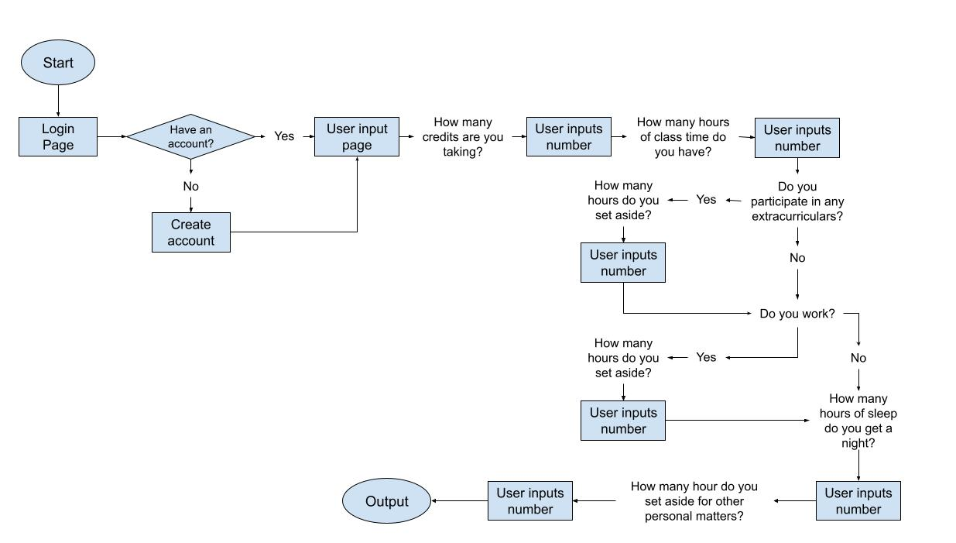
User Flow

Slide 5
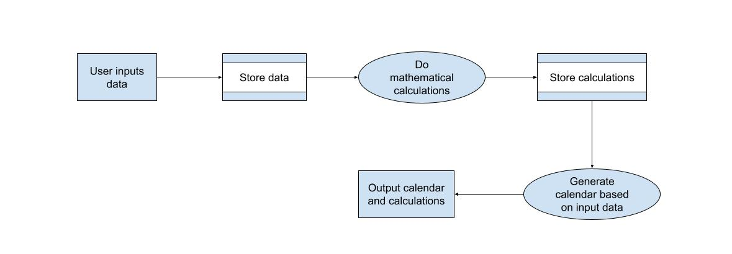
Data Flow Diagram of Application Logic
The user will input data mostly integers or doubles. They will be stored in a database. Then the data will be pulled from the database and some basic arithmetic calculations will be done. Those will then be stored. The program will then generate a study calendar based on the info provided and the calculation and then out put that calendar and the calculations.

Slide 6
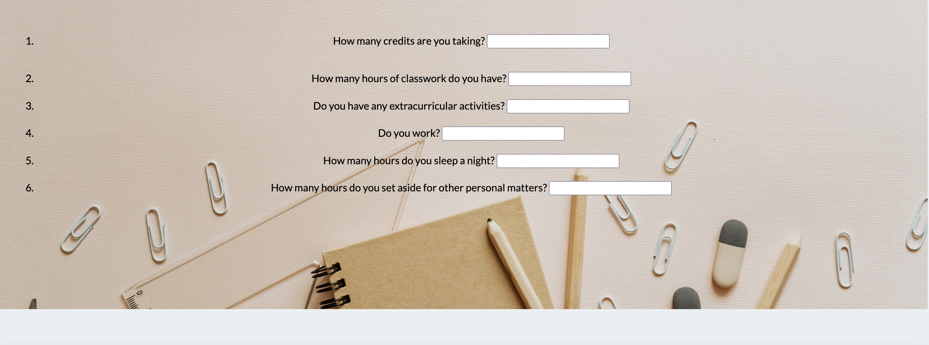
Initial User Interface
We had boxes with fill-ins and based on your answers a calculation or additional questions would pop up.

Slide 7
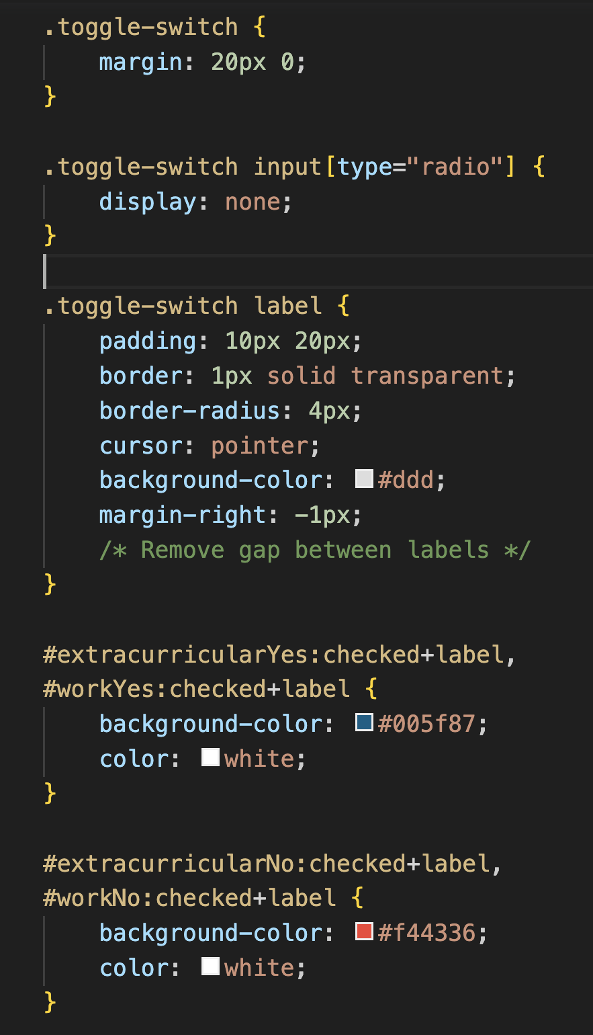

UX/UI Design
We added toggle buttons instead of our initial fill-in of yes or no to applicable questions to make the site more user-friendly

Slide 8
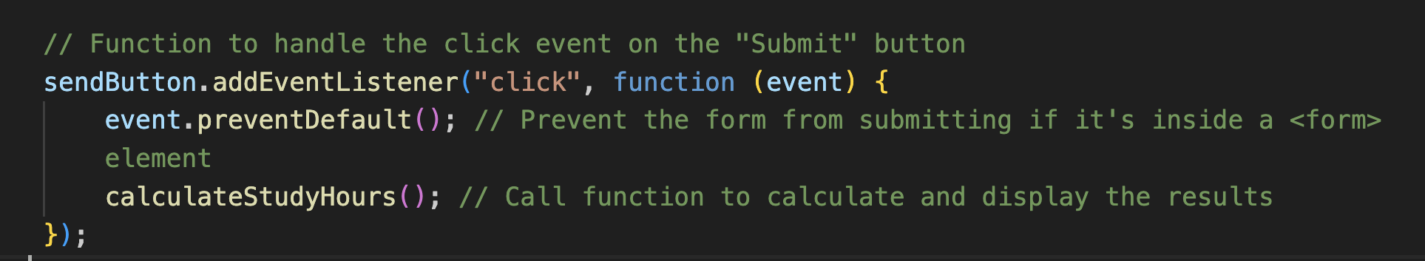
UX/UI Design
We added a submit button at the bottom of the page

Slide 9
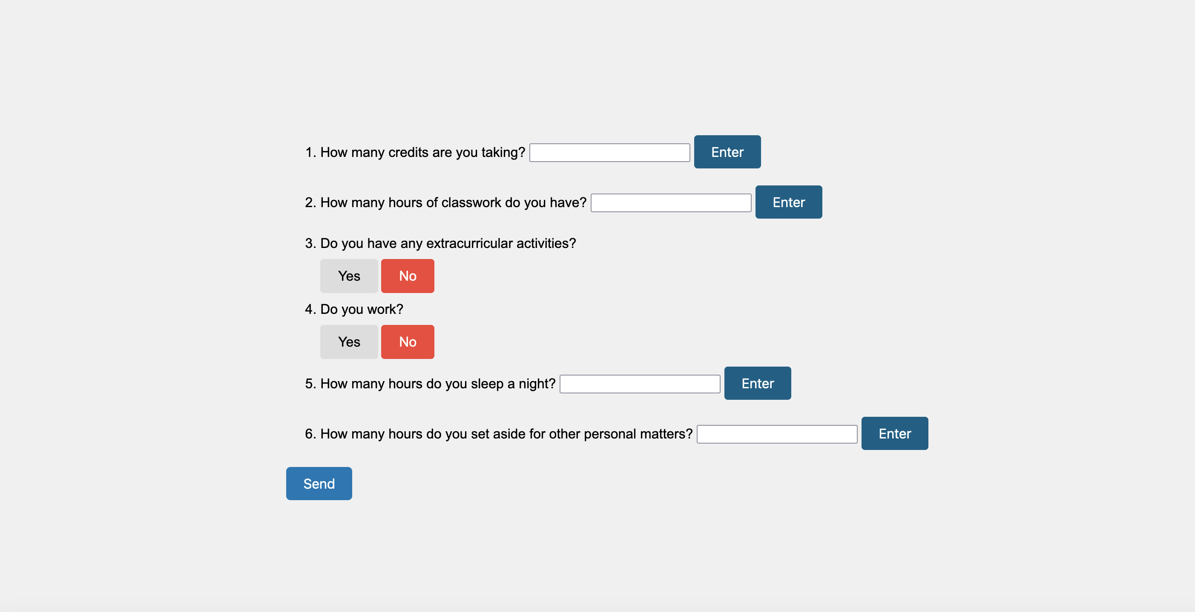
Current User Interface
We are still working on making it look nice, but this is what the updates look like

Slide 10
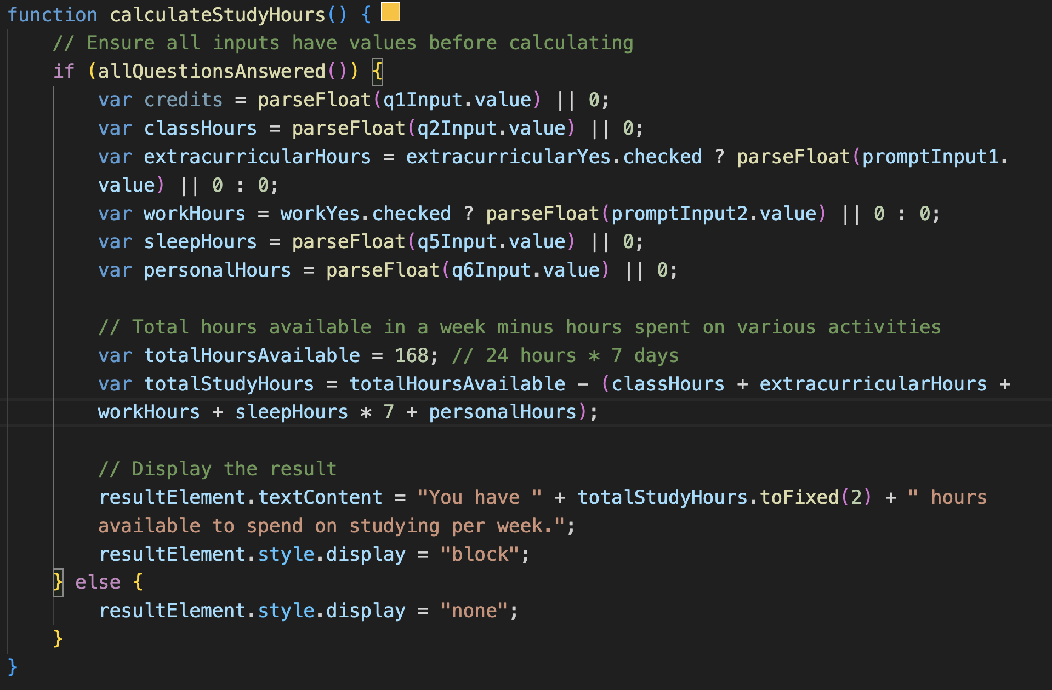
Calculations
Here is the formula used to calculate the time a student needs to allocate for schoolwork

Slide 11
Tentative Schedule
Task | 1 | 2 | 3 | 4 | 5 | 6 | 7 | 8 | 9 | 10 | 11 | 12
Project planning, design, and logic
Make up paperwork (started project late)
Proof of concept
Write code for front end and user interface and test it
Write code for back end/database and test it
Connect to google calendar
Work on final presentation and slides
Work on other course requirements

Slide 12
Use Cases
A freshman student wants to test out possible schedule options and see how the different ones will work with their other obligations and if they will be able to manage their course load. The user must input the necessary data for each variation, and they will receive the different study schedules and calculations. This can help them figure out what schedule and courseload works best for them.
A student who works a job or has an internship wants to ensure that they will have enough time to complete all their schoolwork for that week. The user inputs the necessary data, and the system will output a study schedule if they have enough hours in their week. If not, the program will inform them that they do not have enough time in their week to accomplish everything they want to, and they will have to re-prioritize.
A student wants to track the amount of time they spend studying and doing assignments for each class. The user will input the necessary data each week. They should receive the amount of time allocated for each class (using trackers). Additionally, they should be able to track their studying throughout the semester.

Slide 13

Highlights and Changes
One aspect that we think makes our project unique is that we hope to be able to connect our study schedule to Google Calendar which will make it a lot more user-friendly
We realize that we probably won’t have time to add some of the cool features that we had wanted to originally that would make this project unique for Brooklyn College students, like a map of the Brooklyn College campus and study spaces with their hours.

Slide 14
Project Resources
Github: https://github.com/EV778/StudyTimeCalculator
Project Management Board: https://dassie-company.monday.com/boards/6058892207
*We don’t use our project management board much as there are only 2 of us. We mostly split up work and check in on progress through weekly meetings and texts.

